Slide 1

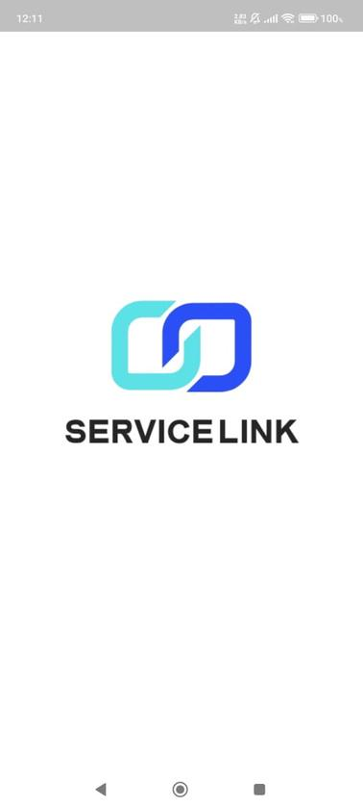
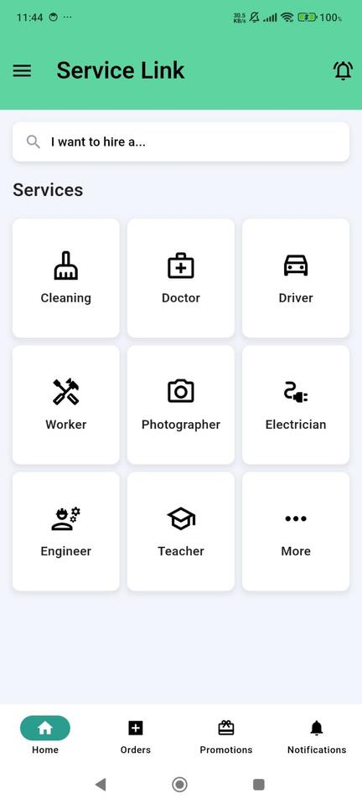
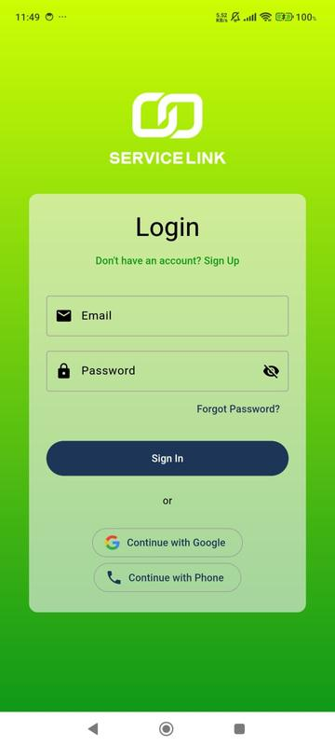
Home
Service
About Us
Contact
Service
Link
Members:
Abdallah Amin Ibrahim
Kerollos Nageh Gabrah
Sofian Moaz Abd Elmohsen
Kerollos Gamel Samwel

Slide 2
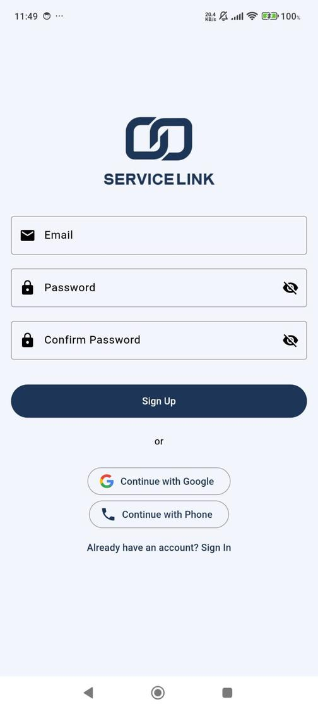
Home
Service
About Us
Contact
Welcome To Our Application
Let’s introduce you to our application!
Our App is designed to assist you in your toughest moments, our app is here when you need it the most. Whether your car breaks down on the road, you require a technician to fix an appliance in your home, or you're looking for a driver to take you anywhere, we’ve got you covered—all in one place for your convenience and peace of mind.
Dive in and discover all that we have to offer!

Slide 3
Home
Service
About Us
Contact
Application Advantages
01
The app allows users to easily access and book various services online from their mobile devices, offering a seamless experience and saving time.
04
Our application brings together doctors, teachers, home service workers, lawyers, and drivers—all in one convenient platform. Instead of downloading multiple apps, to make your experience simpler
02
A modern, intuitive design ensures that users can navigate the app effortlessly, enhancing overall user satisfaction and encouraging repeat usage.
05
Users can get instant notifications and updates about service availability, promotions, or order statuses, keeping them informed and engaged.
03
The app can highlight special promotions or offers, increasing customer engagement and driving service usage, which can boost business revenue.
06
With features like order tracking, chat support, and feedback mechanisms, the app streamlines communication, building trust and reliability between service providers and customers.

Slide 4
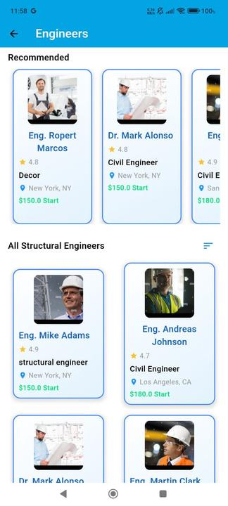
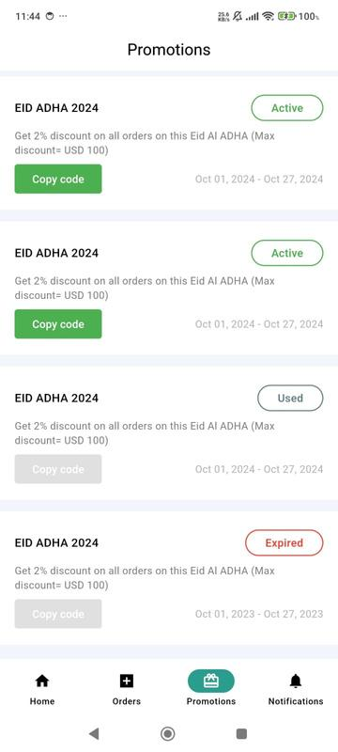
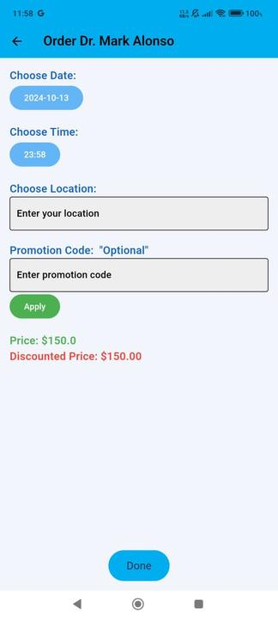
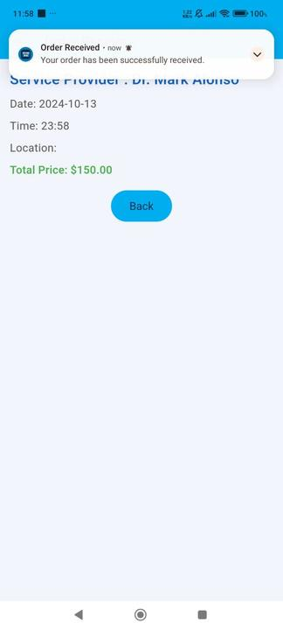
Home
Service
About Us
Contact
Application Features
Finally, Get your final receipt with ability to put a promotion code and get a discount on your order with an Order confirmation notification
01
Organized Services Screens
02
Ability To get a Promotion code
03
Set your Date, Time and Location as you want your order to be
04

Slide 5
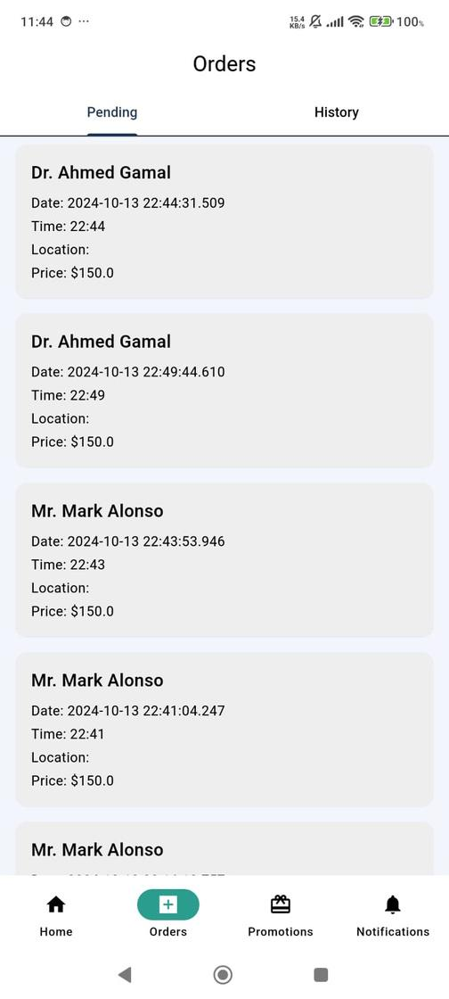
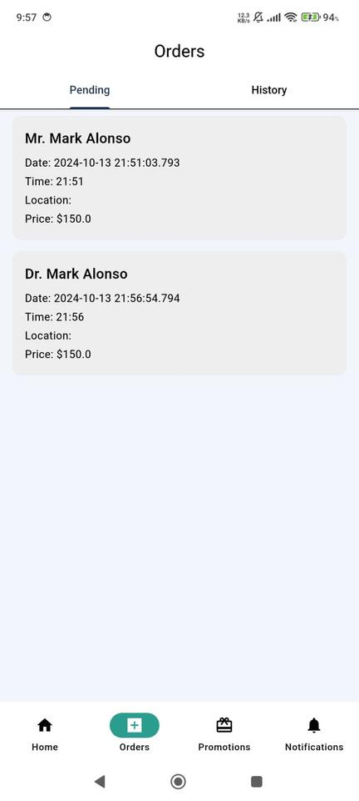
Home
Service
About Us
Contact
Store Orders
The Order Screen stores all the orders that the user submits, keeping a record of each service request for easy tracking and reference.

Slide 6
Home
Service
About Us
Contact
Portfolio 01
Portfolio 03
Portfolio 05
Portfolio 02
Portfolio 04

Slide 7


